Slide 1
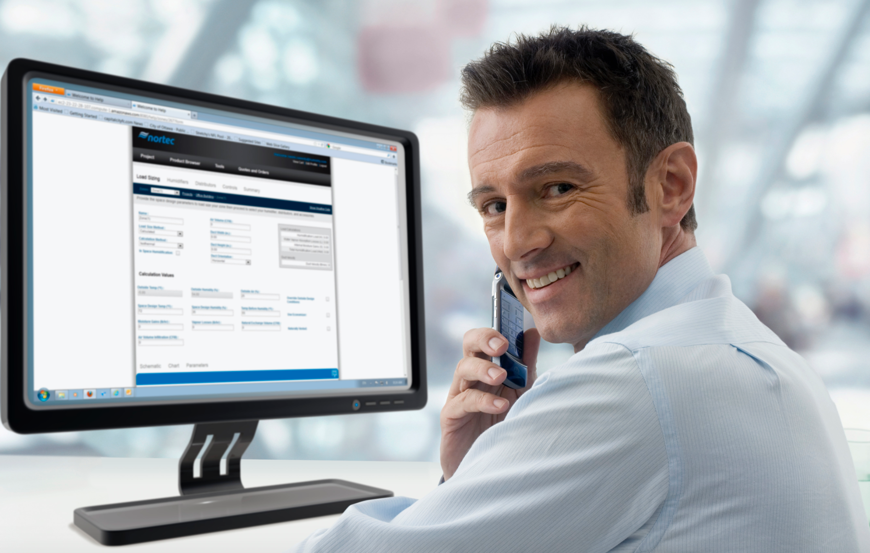
PeopleSoft ERP
FSCM 9.2 UPGRADE
Optum ERP Customers, Contacts and Products Changes

Slide 2

Agenda
Introductions
Objectives
Schedule
Fit Gap
Business Process Deltas between 9.1 and 9.2
Confirm new functionality that should be explored for system design
Customizations
Retrofit / Eliminate
Interfaces
Retrofit / Eliminate
Security
Q&A
Appendix

Slide 3
Introductions
Name
Functional Area
Role

Slide 4
Objectives
An overview of New or updated features in PeopleSoft 9.2 release for Customers, Contacts and Products
Identify Gaps
Confirm Inventory of Interfaces, Customizations and Reports
Determine the Impacts on current business processes
Facilitate the next stage – Upgrade A&D Project

Slide 5
Schedule
Date | Time | Topic
10/13/2016 | 9.30 AM – 11.30 AM (CST) | Business Modeling Session: Customers, Contacts and Products

Slide 6

PeopleSoft 9.2 Customers, Contacts and Products Features

Slide 7
New 9.2 Changes for Customers, Contacts and Products
Customer Hierarchy
Comprehensive Customer View
Business Process Weaver
Data Configuration Workbench
Activity Guides

Slide 8
Customer Hierarchy
PeopleSoft Release 9.2 provides an enhanced Customer Hierarchy to view and report against hierarchical customer relationships :
The customer hierarchy provides transparency to open balances for corporate and subsidiary customers and visibility into total receivables for the customer.
Take actions quickly such as review open balances or put customers on hold.
See details of the top five customers in a hierarchy to get quick insight into which customers have the highest open balances in a corporate hierarchy
Save search criteria.

Slide 9
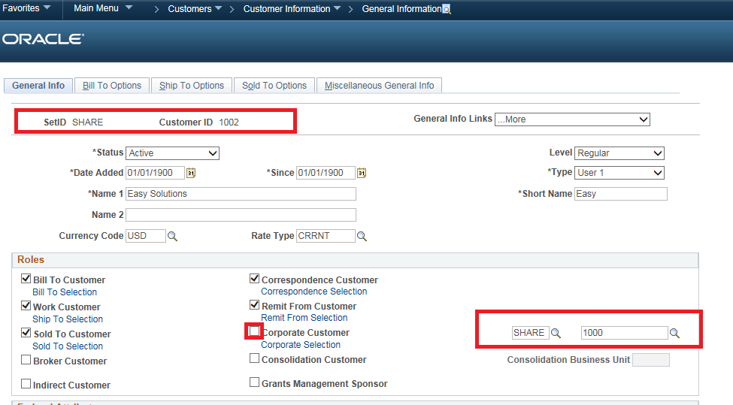
Customer Hierarchy (Continued)

Slide 10
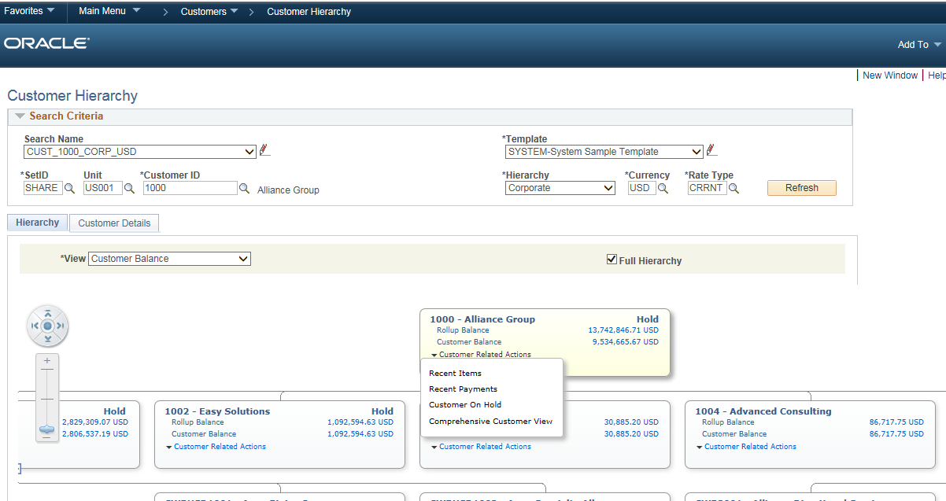
Customer Hierarchy (Continued)

Slide 11
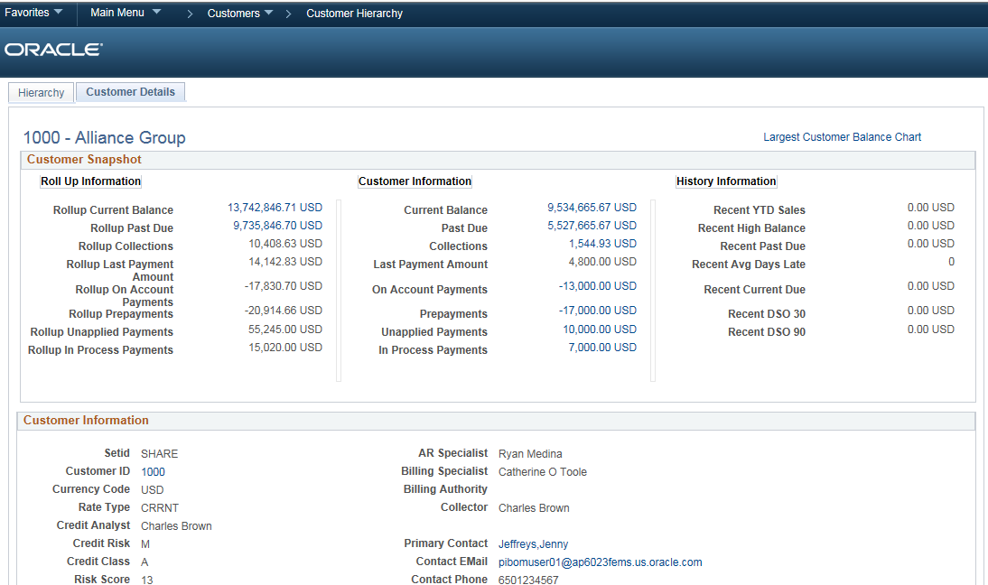
Customer Hierarchy (Continued)

Slide 12
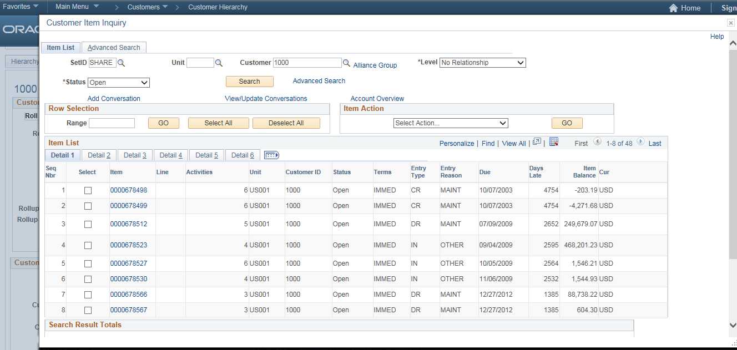
Customer Hierarchy (Continued)

Slide 13
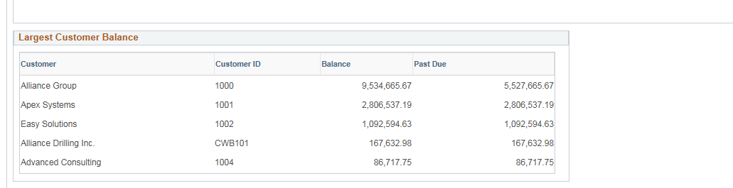
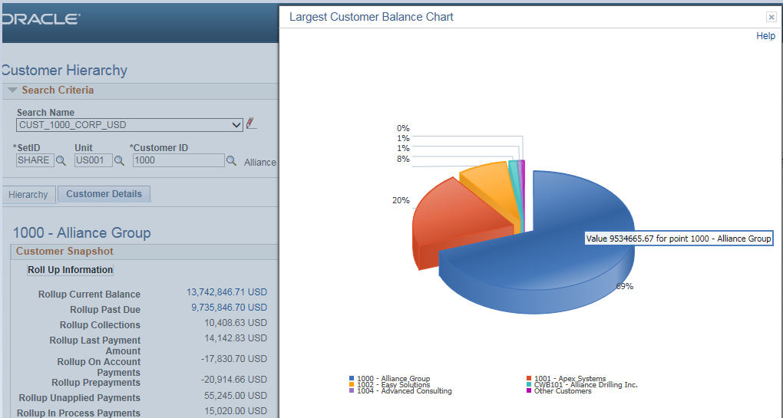
Customer Hierarchy (Continued)

Slide 14
Comprehensive Customer View
Comprehensive Customer View consolidates content focused around key performance indicators into a dashboard, which provides the following:
Customer profile information.
Customer analytics.
Transactional information at both summary and detail levels.
Comparative analysis of customers.
Displays multiple pagelets containing metrics, analytics, graphs, various transaction details, and pivot grids corresponding to customers.
Option to review various metrics related to single or multiple customers in an analysis or comparative view.
The Customer Transaction Wheel provides direct access to transaction pages associated with a customer.

Slide 15
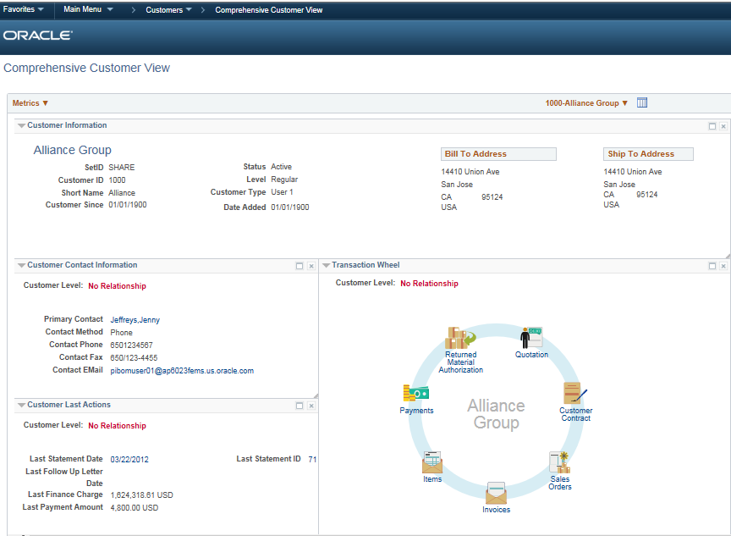
Comprehensive Customer View (Continued)

Slide 16
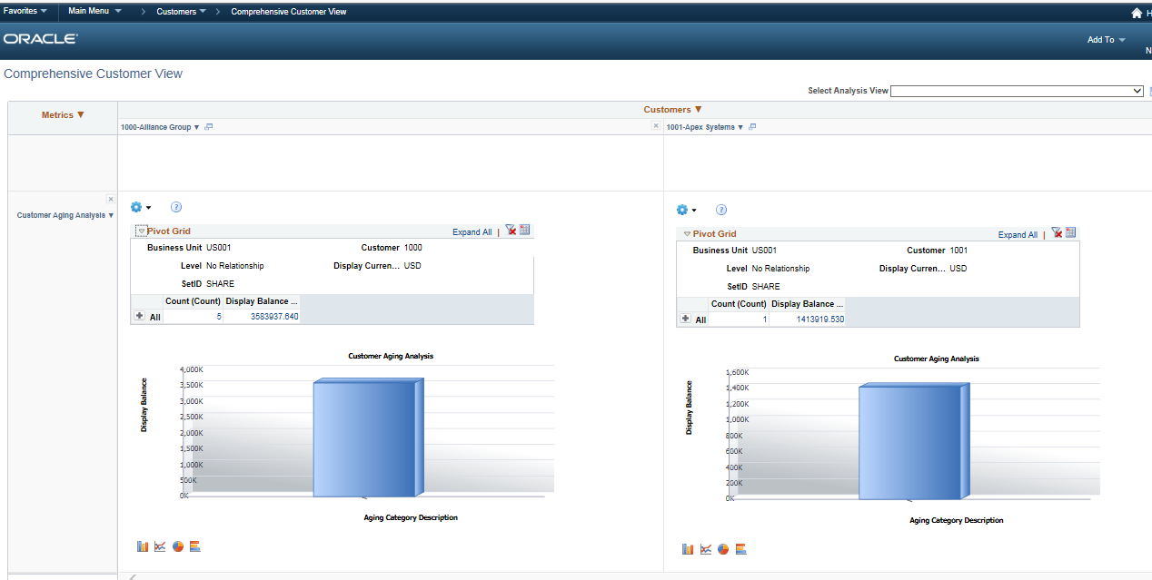
Comprehensive Customer View (Continued)
This example shows the side-by-side comparison of the Aging pivot grid for two customers.

Slide 17
Business Process Weaver
PeopleSoft Business Process Weaver, a visualization and orchestration platform, enables organizations to model, manage, and support the stringing of scheduled processes (both delivered and custom), including the grouping of processes (PSJob) and user interactions.
Ability to string processes together and include user intervention in validating the results before or after specific processes

Slide 18
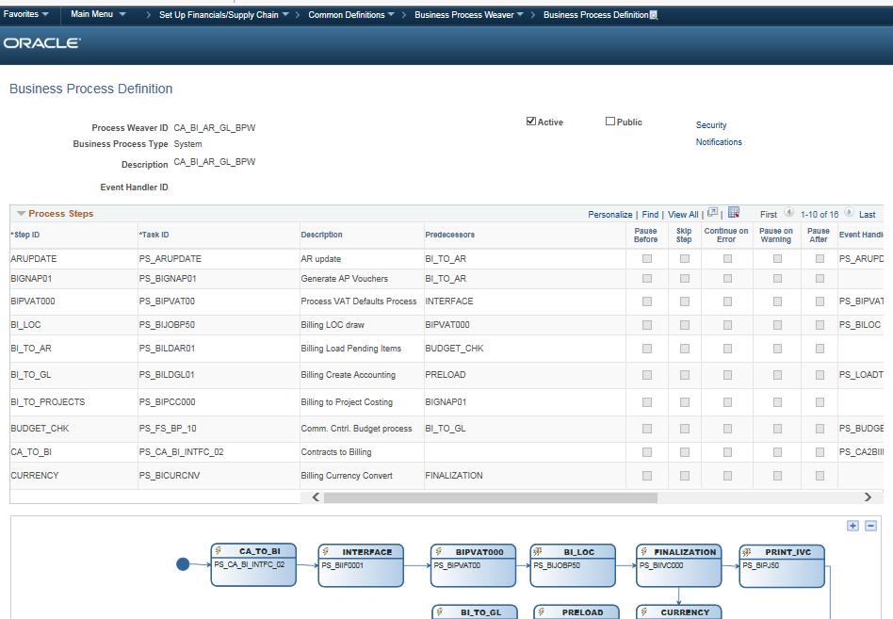
Business Process Weaver
Business Process Definition

Slide 19
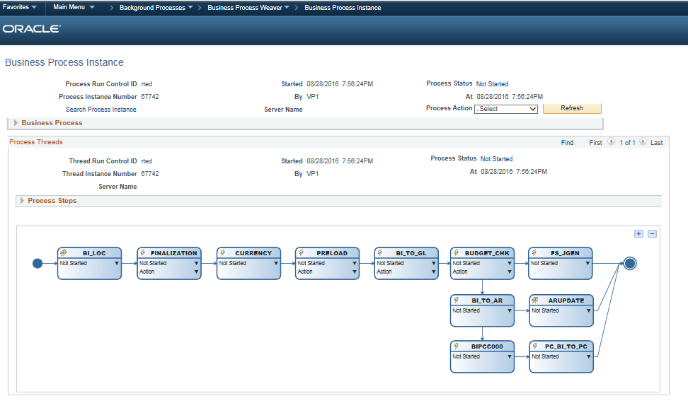
Business Process Weaver
Business Process Instance page
Use the Business Process Instance page to review and control the execution of business processes.

Slide 20
Data Configuration Workbench for Application Data
Enables to compare, validate, and copy application configuration data from one database to another using Application Data Sets (ADS) as its underlying transport technology
Effective alternative to Data Mover scripts
Any authorized developer or administrator can easily define application data sets using the PeopleSoft Pure Internet Architecture (PIA) and compare and copy the data
This functionality is introduced in 9.2 for the following applications:
Allocations
WorkCenters
Accounting Rules
From 9.2 Update Image 14 below are the Application Data Sets which were included:
Aging
Condition Monitor
Payment Predictor

Slide 21
Activity Guides
Activity Guides allow application designers to define processes that guide users through a series of predefined actions to complete a transaction / Process.
Users are presented with a list of actions on their screen which need to be completed to finish a transaction/Process
The configuration allows to specify which steps are optional and which ones are required
Can even launch workflow and approval routing as part of the processing steps
Activity guides are very different from workflow.
Activity Guides – Perform Transactions
Workflows – Approve or Deny
Advantages
Lower Cost & Time needed for Training
Improve data quality to reduce reconciliation issues
Decrease process cycle times to improve cash flows
Measure Individual, Process & Business Performance

Slide 22
Customizations
Customizations | Description of changes | Carry forward
Line of Business | Functionality to identify ‘Line Of Business’ and associate it to a product. This is a effective dated, to track history and upcoming future changes to a product line of business. A new custom screen built to capture and maintain ‘Line Of Business’ values which are then used as prompt values for ‘Line Of Business’ lookup values on the Product Custom Info1 page. | Retrofit
Line of Business Mass update | Whenever changes are made to the LOB value, the corresponding update needs to be done in the respective application downstream transactions. To update the Billing Business Unit value in Bill Plan if it has not progressed LOB value updated in the Additional Line page for contracts Transactional Billing (TBP) entries which are neither billed nor recognized will be updated If the TBP entries are not yet billed AND revenue is not yet recognized, cost category to be updated to new Billing Business Unit based on Bill plan and accounting rule for that Billing Business Unit Update Accounting distribution for existing contracts line with the Product LOB changes A report is generated which shows how many contract distributions are updated and how many are not updated due to change of LOB. | Retrofit

Slide 23
Customizations(Continued)
Customizations | Description of changes | Carry forward
Product Online Changes | Below are the customizations done. Source system ID drop down in Products. CRM and Non-CRM values in the Transaction source identifier field modified to PC, TBP and None. Modified Options, Options2 page names to Selling and Tax, Shipping and Project Options at the product definition level. Product approval functionality. Product Fulfillment System field check box introduced. Tax GL OU and Tax GL BU fields on “Delivery and Additional Data” page for product. Company and Division fields on “Product Custom Info1” page. “Delivery and Additional Data” page for Product. | Retrofit
Customers/Contacts Online Changes | Below are the customizations done. Source system ID drop down in Customers and Contacts Interunit Billing Group box fields in the Bill To Options page at Customer setup level is frozen for all the users. Customer – Preferred communication method defined at Customer level and the same is cascaded down to Contacts associated with the customer. Customer name has been split into fields NAME1, NAME2 to store full customer name as received from Salesforce. “User Defined Fields” page for Customer. Customer information page modified to display the Customer’s full name. Contact information page modified to display the Contact full name. | Retrofit

Slide 24
Customizations(Continued)
Customizations | Description of changes | Carry forward
SalesForce Contact Information | Custom Page created to hold the data coming from SF before updating the Contact Details in Contact Page. | Retrofit
SalesForce Account Information | Custom Page created to hold the data coming from SF before updating the Customer Details in Customer Page. | Retrofit
Configure Optum Business | Custom page created to configure the Optum business values in PS. | Retrofit /Eliminate?
Data Conversion | Following are the processes which were developed as part of the data conversion loads Load Item staging data Load Product staging data Product load Contact Staging Load Contact Creation Load Customer staging tables Customer Creation Link Customer to Contacts | Retrofit
Map Contact address to customer | Custom process created for mapping customer and contact roles and addresses | Retrofit /Eliminate?

Slide 25
Customizations(Continued)
Customizations | Description of changes | Carry forward
Customer Collector Assignment | Custom process to update the customer with the assigned Collector based on the criteria configured by the business user in the Customer Collector Assignment rules page. New custom page/Records to capture the collection rules criteria. Based on defined criteria, collector will be assigned to a customer. | Eliminate
File Archival | Custom process created to archive the Product Fulfillment data files. | Eliminate
Inbound Product fulfillment process | Custom process to upload Product Fulfillment data from Flat file to Products table. | Eliminate
Outbound Product fulfillment process | Custom process to generate a flat file which contains delta change of the contracts which is send to the Product fulfillment system | Eliminate
Customer Merge process | Custom process created to merge customers | Retrofit /Eliminate?
Customer Request Transformation | Transformation code applied to the routing in order to trim the first 10 characters that are sent as part of the customer request XML | Retrofit
Invoice Reprints | Users are unable to reprint an invoice from “Billing > Generate Invoices > Non-Consolidated > Reprint Invoices” as the old customer address gets inactivated when salesforce creates a new customer address in PeopleSoft. | Retrofit/Revisit

Slide 26
Interfaces
Interface | Description of changes | Carry forward
Product Create/Update | Custom process created to send the New/Updated PeopleSoft product data to Salesforce | Retrofit
Contact Create | Custom Web Service built in PeopleSoft to pass the details of Contacts created in Salesforce. | Retrofit
Customer Create/Update | Custom Web Service built to pass the details of Customers Created/Updated in Salesforce. | Retrofit

Slide 27
Security
Pages
All the new pages delivered as part of the PS 9.2 needs to be assigned to custom permission lists
Process
Any new process introduced in PS 9.2 needs to be assigned appropriate process groups.
Review security matrix

Slide 28



Questions?

Slide 29
Appendix

Slide 30
PeopleSoft 9.2 Global Enhancements

Slide 31
Oracle Secure Enterprise Search (SES)
Provides global search capabilities that enables the user to take action from search results without navigating through the menus thereby increasing productivity
SES is implemented through the PeopleSoft Search Framework. The PeopleSoft Search Framework replaces the Verity search engine and provides a standard method to create search indexes for PeopleSoft applications
SES indexing is available in these areas of PS FSCM
Assets, Expenses, Journals, Payments, Procurement Contracts, Purchase Orders, Receiving in Purchasing, Requisitions in Purchasing and eProcurement, Strategic Sourcing Events, Suppliers, Supplier Conversations, Vouchers

Slide 32
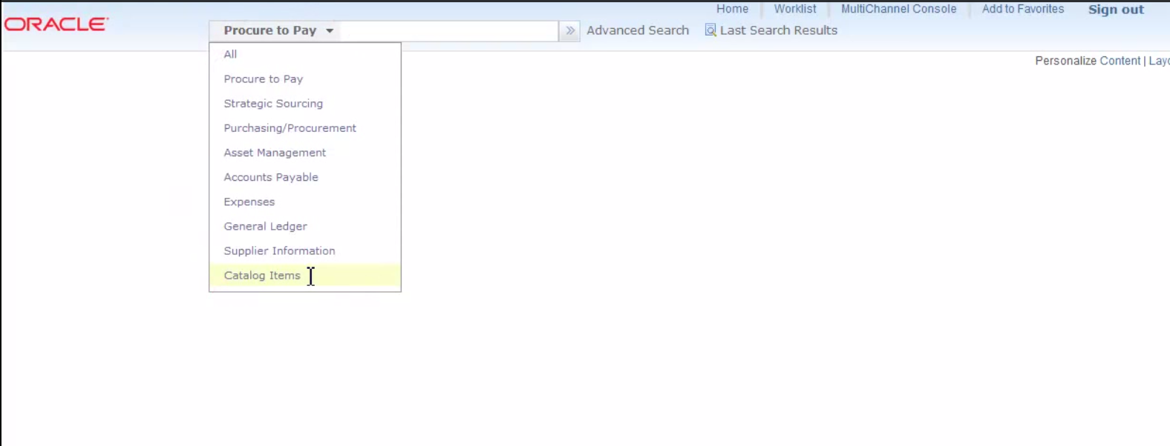
Oracle Secure Enterprise Search (SES) – Cont.
Example

Slide 33
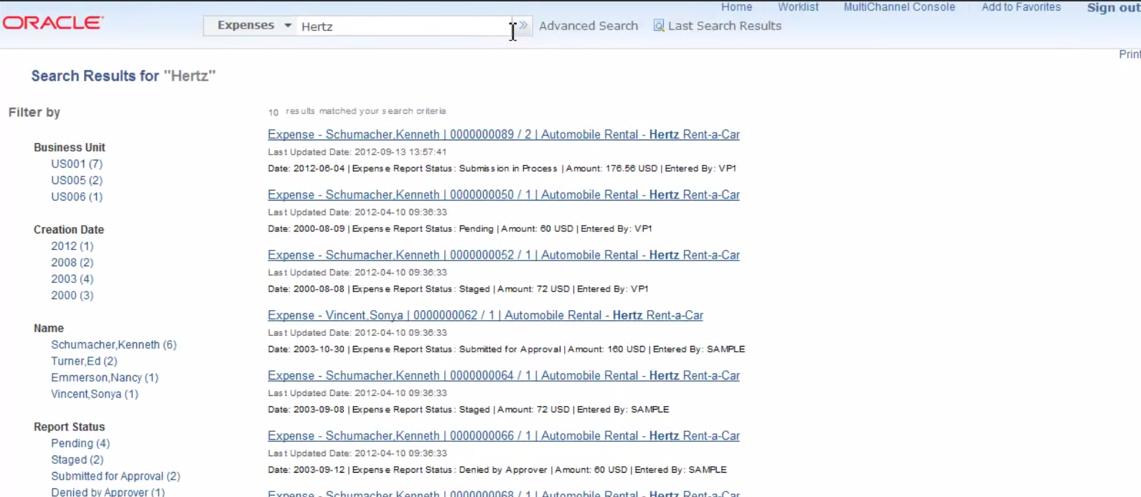
Oracle Secure Enterprise Search (SES) – Cont.

Slide 34
Alignment, Order and Positioning
Alignment
In PeopleSoft 9.1, all of the search and transaction fields were aligned to the left side of the page
In PeopleSoft 9.2, all of the search and transaction field labels will be right aligned to the fields
Order and Positioning
Order and position of fields on the page may have changed
Function is not impacted or changes as a result

Slide 35
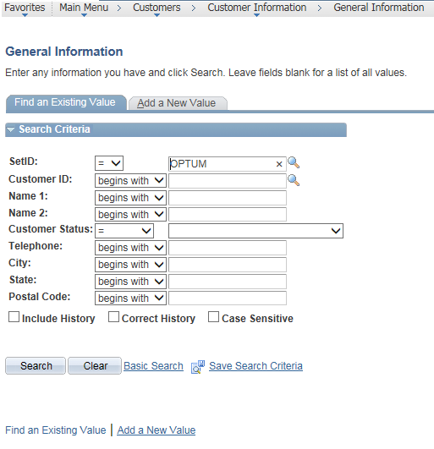
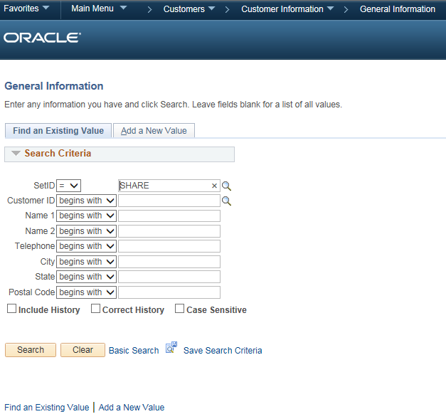
Alignment, Order and Positioning – Cont.
PeopleSoft 9.1 PeopleSoft 9.2

Slide 36
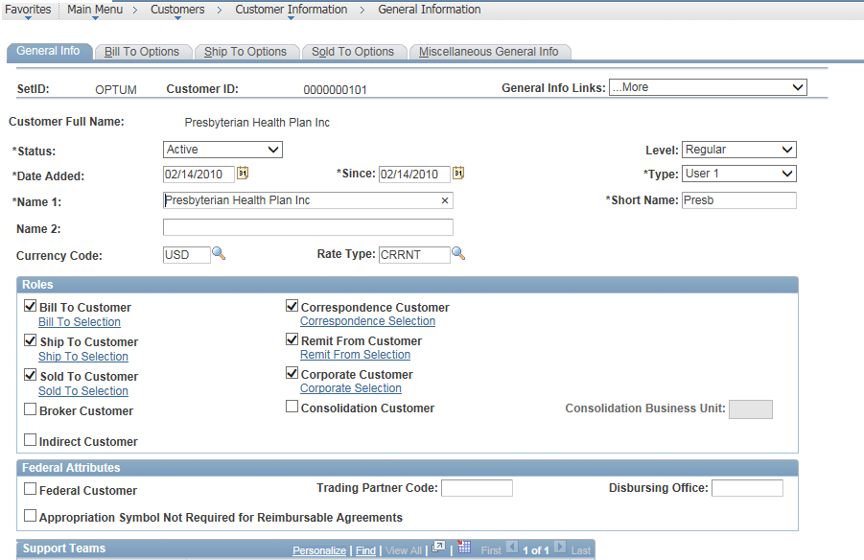
Alignment, Order and Positioning – Cont.
PeopleSoft 9.1

Slide 37
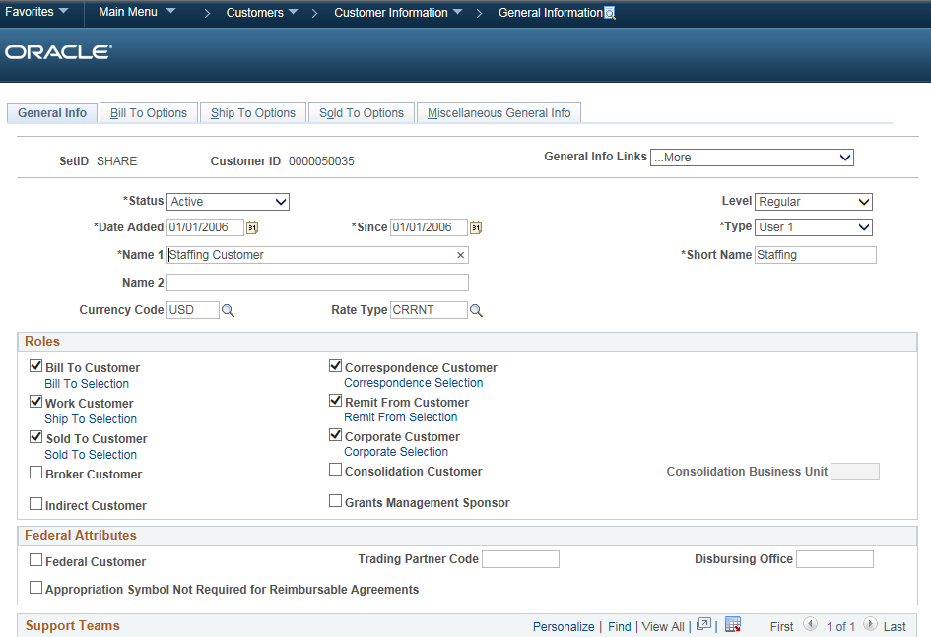
Alignment, Order and Positioning – Cont.
PeopleSoft 9.2

Slide 38
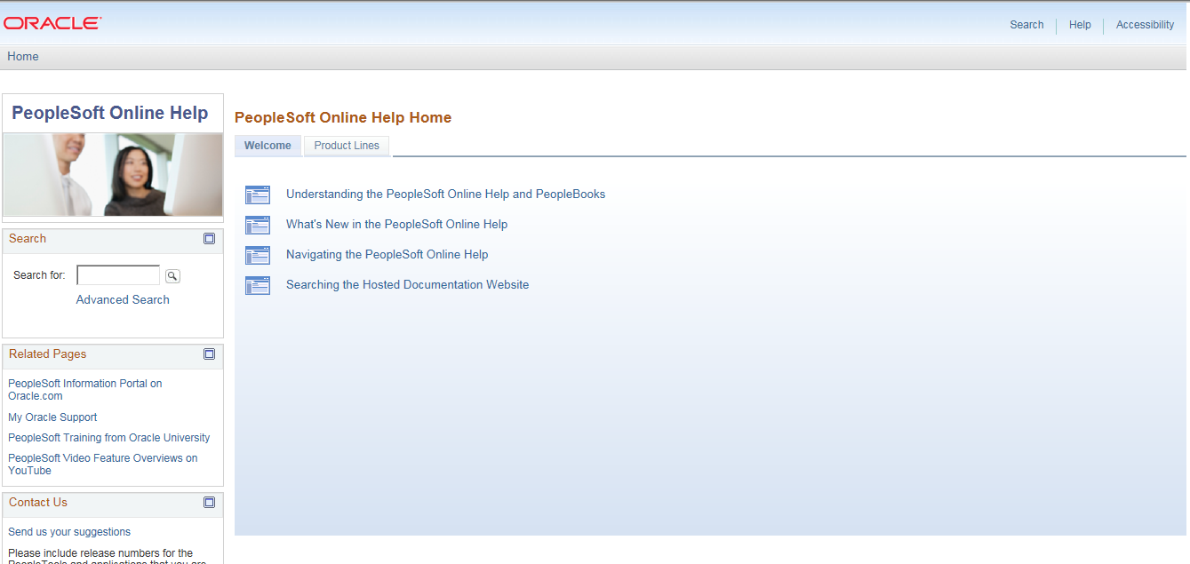
New PeopleSoft Online Help Solution
Starting with 9.2, PeopleSoft delivers a new help solution interface that looks and functions much like a website rather than the book format structure for help documentation in the past. The new online help solution includes these features:
A modern user interface to engage with the application help content.
A new content structure that allows for a more intuitive help-content to application-page relationship.
A Business Process Map (BPM) graphical integration and navigation with the online help documentation.
Embedded media, such as feature demonstration videos and audio files.

Slide 39
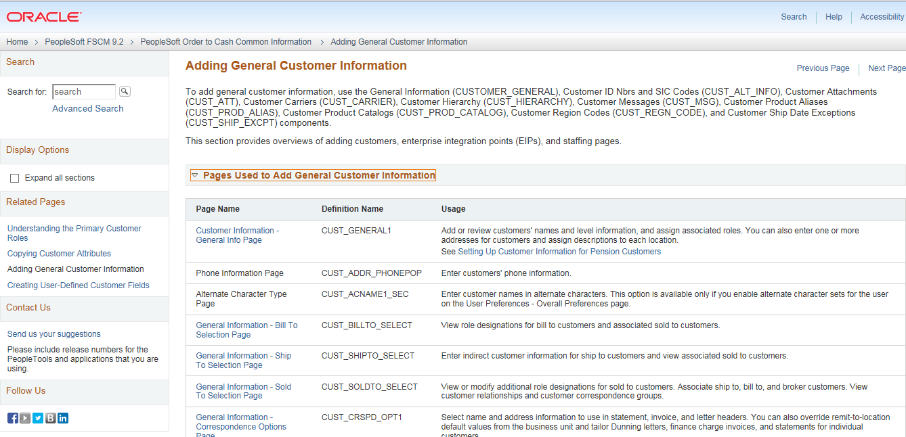
New PeopleSoft Online Help Solution – Cont.
The new help solution provides a navigation option similar to the websites users are already familiar with
Offers the same robust documentation but with more options for accessing the help easily and quickly

Slide 40
Thank you
Contact information
Vinod Kumar Malothu
#+91 40-396-85223
vinod_malothu@optum.com

